Slide 1
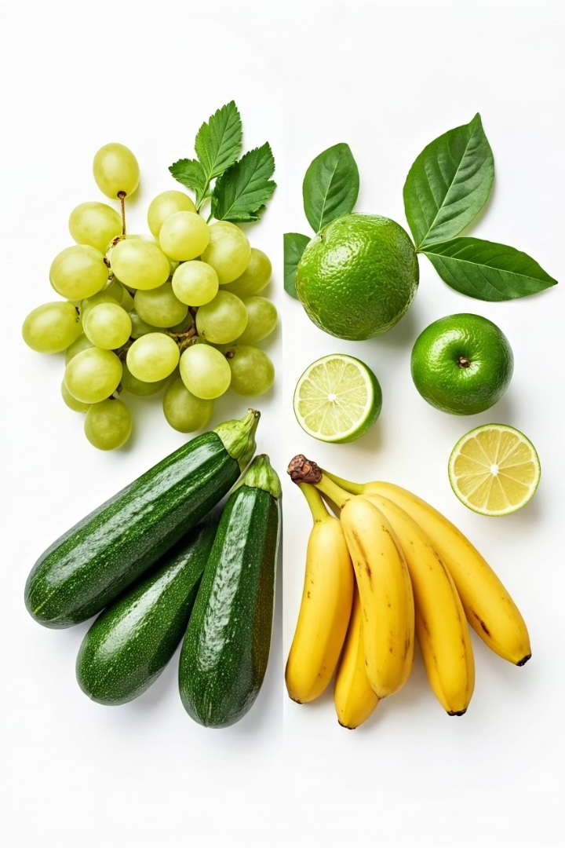
Food Freshness Evaluation Using CNNs
Project by Team 15: CSCE:5218 Deep Learning
Praharsha Mutyala
Murali Manobhiram Penumutchu

Slide 2
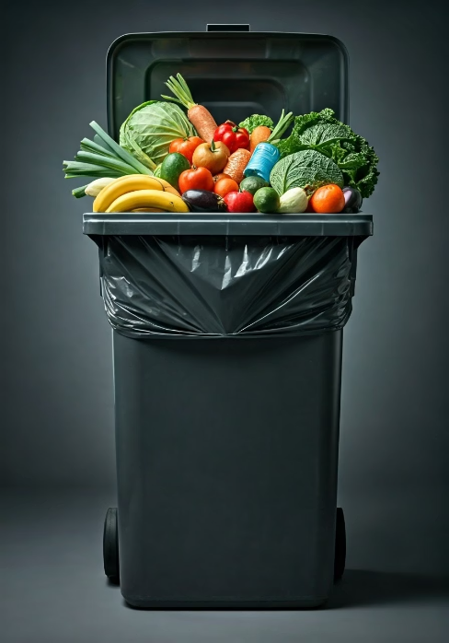
The Problem
Our project addresses the problem of food waste, which is compounded by ineffective food quality inspections. Current approaches frequently rely on subjective and unreliable human evaluation. This leads to the waste of edible food and delays in identifying ruined food. Our goal is to create an automated image analysis model that accurately classifies food as 'Fresh' or 'Rotten' based on photographs, thereby minimizing food waste and encouraging the consumption of useful food.

Slide 3
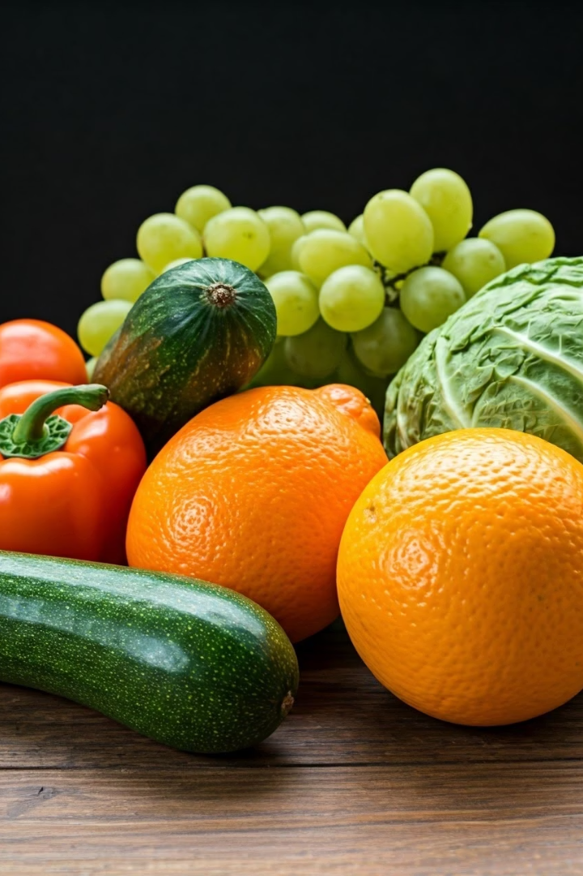
Dataset Details
We used the 'Fresh and Rotten Classification Dataset' for our research. This dataset contains a vast number of photos depicting 14 different fruits and vegetables. Each image falls into one of two categories: 'Fresh' or 'Rotten. The dataset consists of three subsets: a training set of 21,093 photos, a testing set of 5,263 images, and a validation set of 2,921 images.

Slide 4
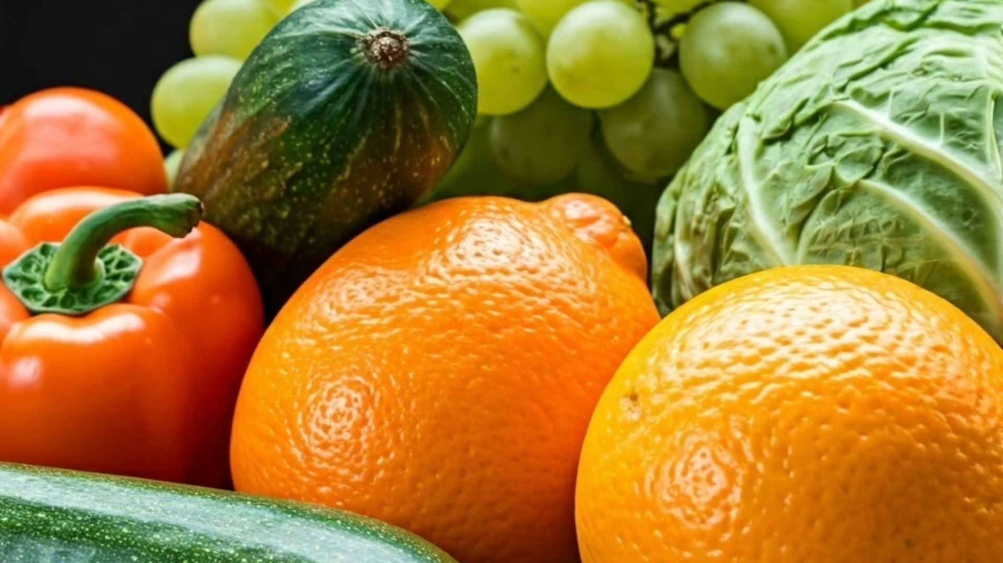
Dataset Details
Training Images
Validation Images
For model development
For parameter tuning
21,093
5,263
Testing Images
Food Types
For final evaluation
Including apples, bananas, oranges, carrots, cucumbers
2,921
14

Slide 5

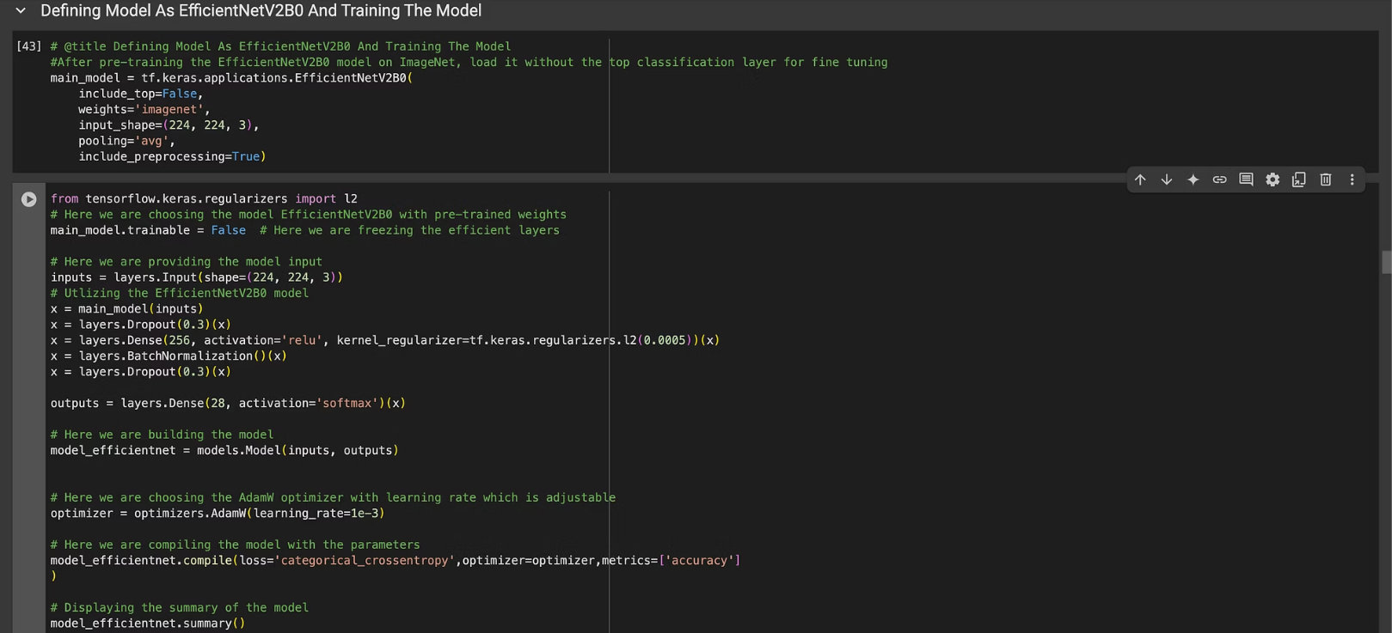
Proposed Model-EfficientNet Model

Slide 6

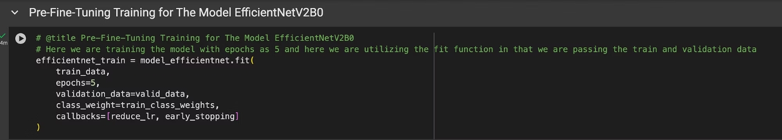
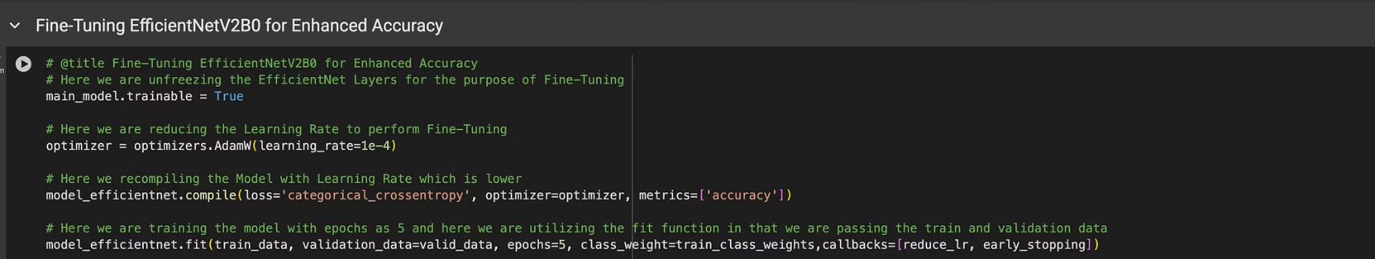
Proposed Model-EfficientNet Model

Slide 7

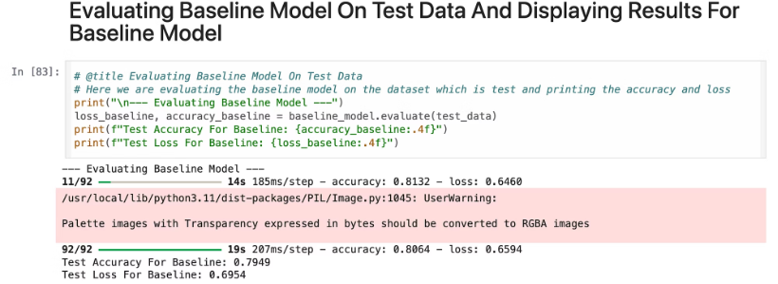
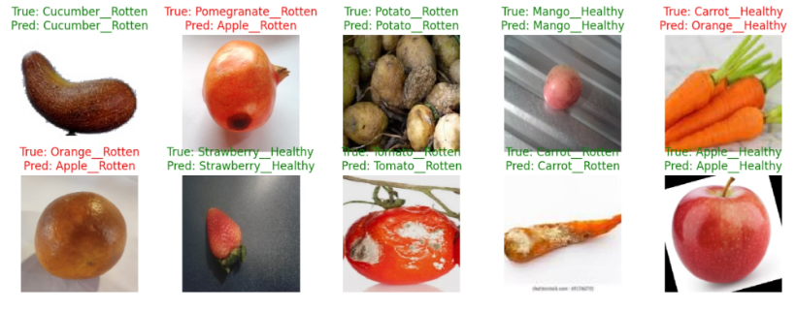
Results-Baseline Model

Slide 8

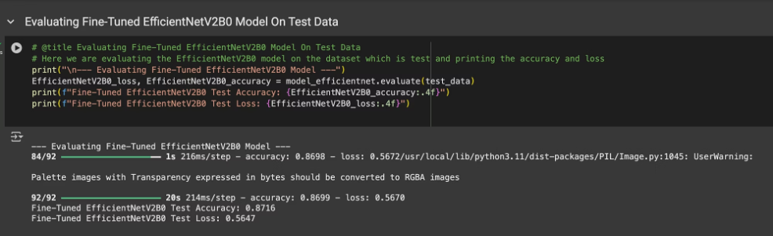
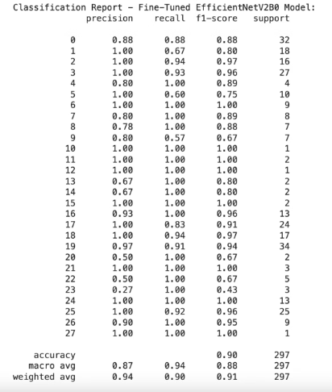
Results-Efficientnet Model-Accuracy and Classification Report
Here we evaluating the fine-tuned EfficientNetV2B0 model on the withheld test dataset, and i got the results as:
Fine-Tuned EfficientNetV2B0 Test Accuracy: 0.8716, Fine-Tuned EfficientNetV2B0 Test Loss: 0.5647

Slide 9

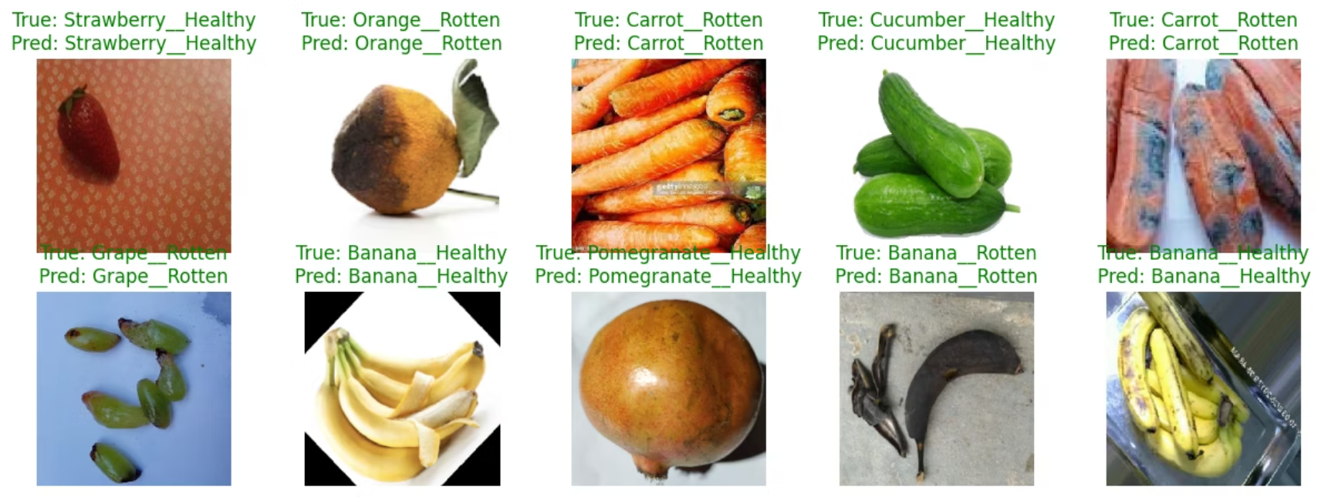
Visualization Results
Here we are using the efficient net model to make the predictions on the test data where all the predictions made by the model are accurate

Slide 10

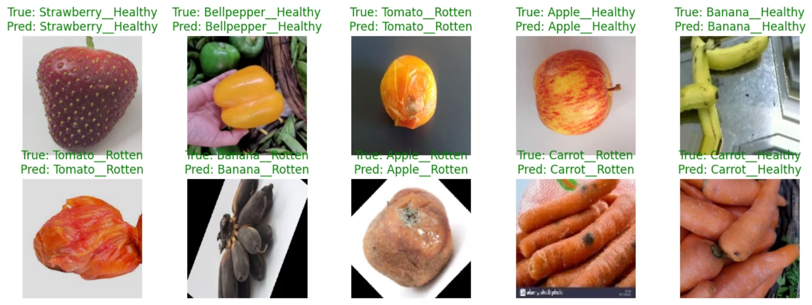
Visualization Results

Slide 11

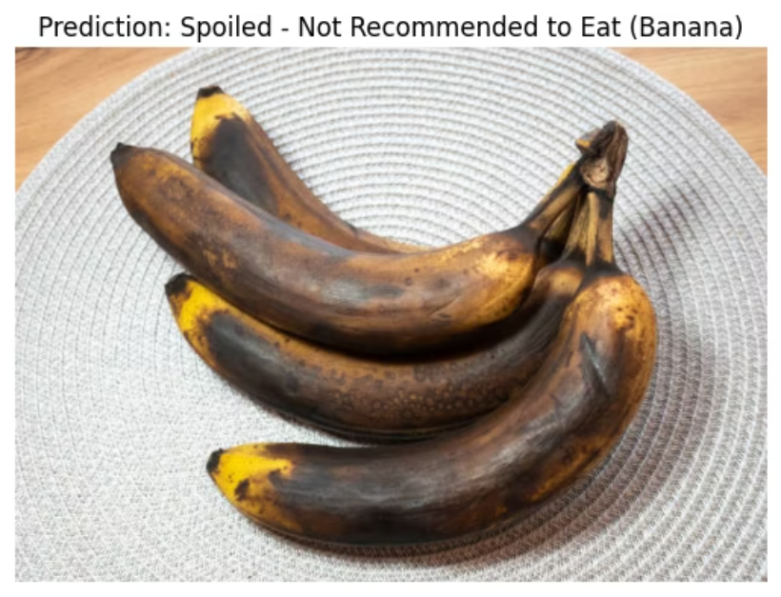
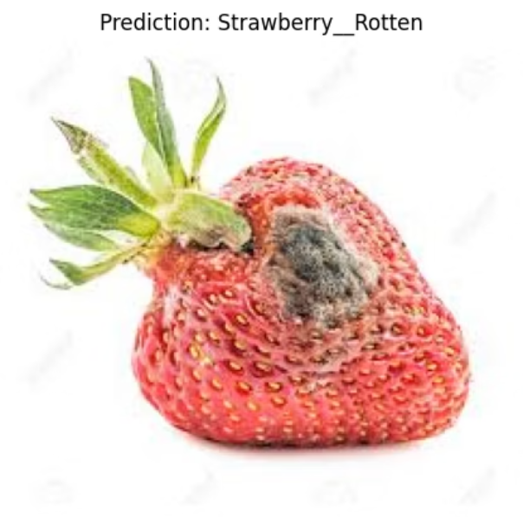
Visualization Results

Slide 12
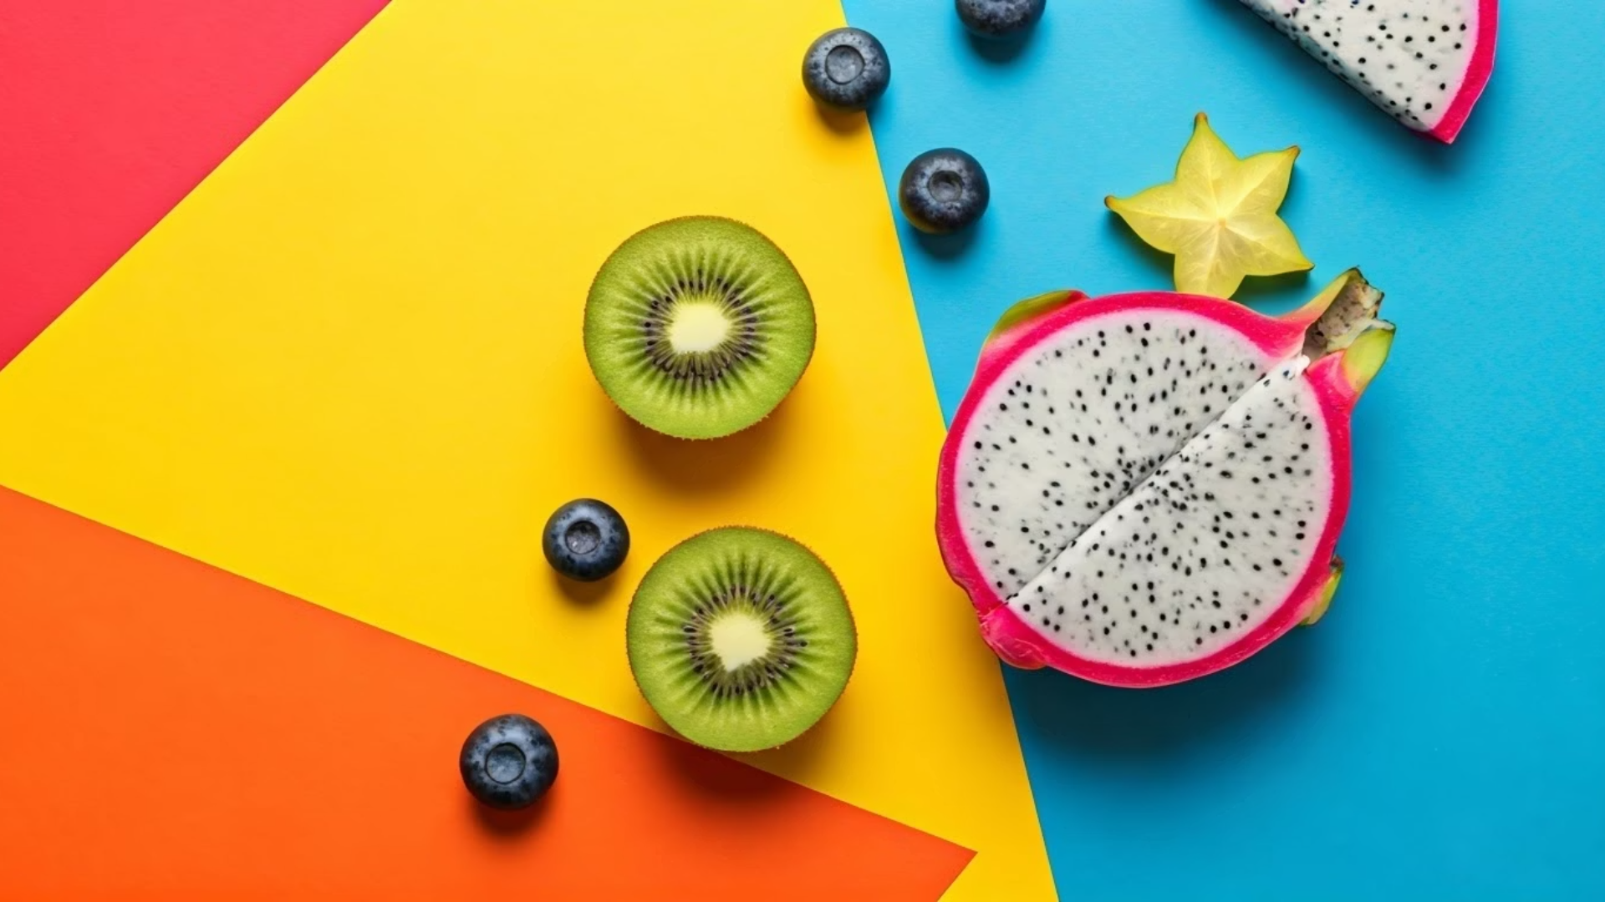
Discussion
"The EfficientNetV2B0 model outperformed the baseline CNN model, demonstrating the efficacy of this architecture for food freshness classification. We used data augmentation to remedy the dataset's class imbalance. During fine-tuning, we saw a risk of overfitting, which we minimized with an early stopping strategy. Our findings are consistent with previous studies, demonstrating that pre-trained CNNs such as EfficientNet are a promising strategy for food image categorization.

Slide 13

THANK YOU

